Slide 1
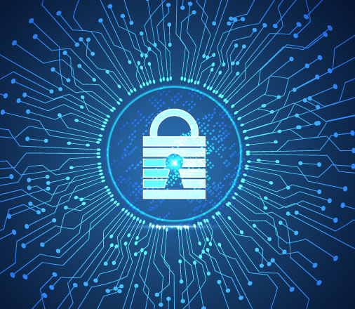

IT Data Security Lecture Series
V Semester CSF
Dr. Narendra Kumar Dewangan
Assistant Professor, Senior Scale
Systems, School of Computer Sciences
UPES Dehradun

Slide 2
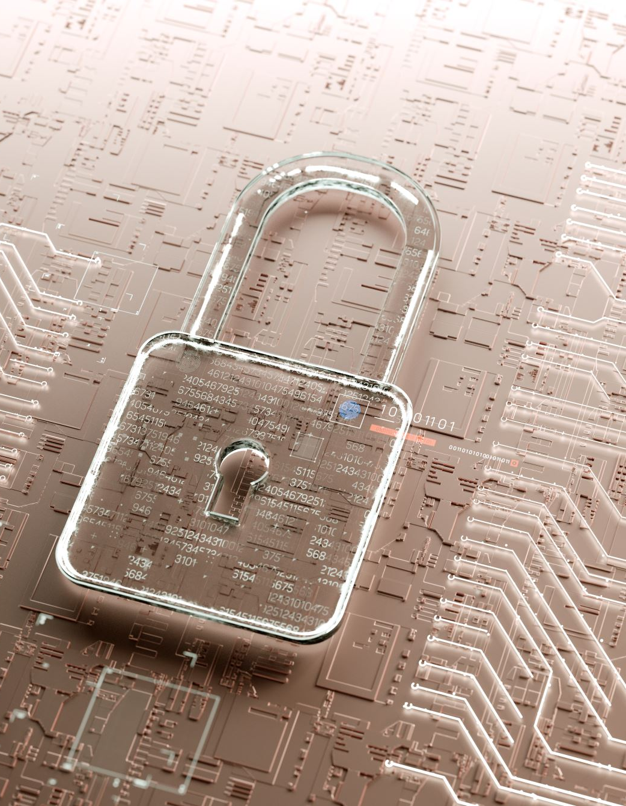
Contents
Background
Need of Data Security
Importance of Data Security
Critical Data for Organization
Elements for Better Data Security

Slide 3
Background
The concept of data security has evolved significantly over time, influenced by the development of technology, the increasing value of information, and the growing complexity of threats

Slide 4
History of Data Security
Early Beginnings (Pre-20th Century)
Ancient Encryption: The earliest forms of data security can be traced back to ancient times, where simple encryption techniques were used to protect information. One of the earliest known examples is the Caesar Cipher, used by Julius Caesar to encrypt military messages by shifting letters in the alphabet.
Classical Cryptography: Throughout history, various civilizations developed more complex methods of encryption to secure communications. For example, the Vigenère Cipher, invented in the 16th century, was a polyalphabetic cipher that was considered unbreakable for centuries.

Slide 5
History of Data Security
World Wars and the Rise of Cryptography (20th Century)
World War I and II: The World Wars marked significant advancements in cryptography and data security. During World War I, encryption was used extensively for military communications. In World War II, cryptographic machines like the German Enigma and the British Colossus were pivotal in securing and deciphering messages, influencing the outcomes of battles.
The Birth of Modern Cryptography: The work of cryptographers like Alan Turing during World War II laid the groundwork for modern cryptography. Turing’s work in breaking the Enigma code and his contributions to early computing were instrumental in the development of the field.

Slide 6
History of Data Security
The Computer Age (1950s - 1970s)
Mainframes and Early Security Concerns: As computers became more widespread in the 1950s and 1960s, the need for securing data stored and processed on these machines became apparent. Early security measures focused on physical security, such as controlling access to mainframe computers.
Time-Sharing Systems: In the 1960s, the development of time-sharing systems, where multiple users shared the same computing resources, introduced new security challenges, such as ensuring that one user could not access another user's data. This period saw the early development of access controls and user authentication mechanisms.
The Birth of Public-Key Cryptography: In 1976, Whitfield Diffie and Martin Hellman introduced the concept of public-key cryptography with their publication on the Diffie-Hellman key exchange. This breakthrough allowed for secure communication over insecure channels and laid the foundation for many modern encryption protocols.

Slide 7
The Internet Era (1980s - 1990s)
Growth of Computer Networks: The 1980s saw the growth of computer networks and the emergence of the internet. This expansion brought new security challenges, such as securing data transmitted over public networks. During this time, firewalls and intrusion detection systems (IDS) began to be developed and deployed.
The Morris Worm: In 1988, the Morris Worm became one of the first widely recognized examples of a computer worm, highlighting the need for better network security and leading to increased awareness of cybersecurity threats.
The Advent of Secure Communication Protocols: The late 1980s and early 1990s saw the development of secure communication protocols, such as Secure Sockets Layer (SSL) by Netscape, which enabled encrypted communication over the internet. SSL later evolved into Transport Layer Security (TLS), which is widely used today.

Slide 8
The Rise of Cybersecurity (2000s - Present)
Advanced Threats and Cyber Warfare: The modern era has seen the rise of advanced persistent threats (APTs) and state-sponsored cyberattacks, which have become significant concerns for national security and critical infrastructure. Incidents like the Stuxnet attack in 2010 and the SolarWinds breach in 2020 underscore the complexity and scale of modern cyber threats.
Artificial Intelligence and Machine Learning in Security: The integration of AI and machine learning into cybersecurity has become a significant trend, enabling more sophisticated threat detection, automated response, and predictive analytics to anticipate and mitigate potential attacks.
Zero Trust Architecture: The adoption of the Zero Trust security model, which assumes that threats could be both external and internal, emphasizes continuous verification and monitoring rather than relying solely on perimeter defenses. This approach has gained traction as organizations face increasingly sophisticated and diverse threats.

Slide 9
The Rise of Cybersecurity (2000s - Present)
Data Breaches and Cyber Attacks: The 2000s witnessed an explosion in the number of data breaches and cyberattacks, as the internet became more ubiquitous and digital information more valuable. High-profile incidents, such as the TJX data breach in 2007 and the Yahoo data breach in 2013, exposed the vulnerabilities of large-scale data storage and highlighted the need for stronger data security measures.
Regulatory Responses: In response to the increasing number of data breaches, governments around the world began to implement stringent data protection laws and regulations. The General Data Protection Regulation (GDPR) in the European Union, enacted in 2018, set new standards for data privacy and security, with significant penalties for non-compliance.
Cloud Computing and New Challenges: The rise of cloud computing introduced new challenges and opportunities for data security. Organizations began moving their data to cloud services, requiring new approaches to securing data in the cloud. This led to the development of cloud security tools and practices, such as encryption, identity and access management, and secure cloud architectures.

Slide 10
Need of Data Security
Protection of Sensitive Information
Compliance with Legal and Regulatory Requirements
Preventing Data Breaches
Ensuring Business Continuity
Maintaining Customer Trust
Protection Against Financial Loss
Safeguarding Intellectual Property
Mitigating Insider Threats
Ensuring Ethical Responsibility
Ensuring Ethical Responsibility

Slide 11
Protection of Sensitive Information
Personal Data: Personal information such as social security numbers, medical records, financial information, and other personally identifiable information (PII) must be protected to prevent identity theft and privacy breaches.
Corporate Data: Companies need to protect sensitive business information such as trade secrets, intellectual property, strategic plans, and customer data from competitors and cybercriminals.

Slide 12
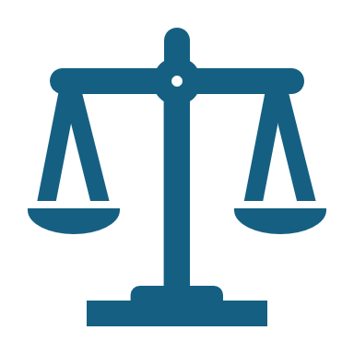
Compliance with Legal and Regulatory Requirements
Data Protection Laws: Many regions have stringent data protection laws (e.g., GDPR in Europe, CCPA in California) that require organizations to implement strong data security measures to protect personal data.
Industry Standards: Specific industries have standards like PCI-DSS for payment card information, HIPAA for healthcare information, and others that mandate the protection of sensitive data.

Slide 13

Preventing Data Breaches
Cyber Threats: The rise in cyberattacks, including hacking, phishing, ransomware, and insider threats, necessitates robust data security measures to prevent breaches that can lead to significant financial and reputational damage.
Data Integrity: Ensuring that data is not altered or tampered with during storage or transmission is crucial for maintaining its accuracy and reliability.

Slide 14
Ensuring Business Continuity
Disaster Recovery: Data security measures, including backups and encryption, are essential for disaster recovery. They ensure that data can be restored and business operations can continue after a cyberattack, hardware failure, or natural disaster.
Availability: Ensuring that data is accessible only to authorized users when needed is crucial for the smooth operation of business processes.

Slide 15
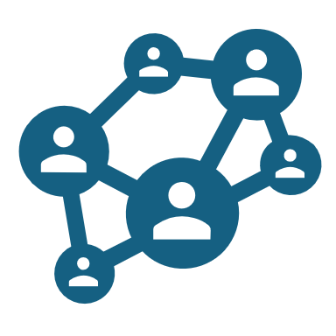
Maintaining Customer Trust
Reputation Management: Customers trust organizations with their personal data. A breach or misuse of this data can severely damage an organization’s reputation, leading to loss of customers and revenue.
Customer Confidence: Implementing strong data security practices helps build and maintain customer confidence in a company's ability to protect their data.

Slide 16
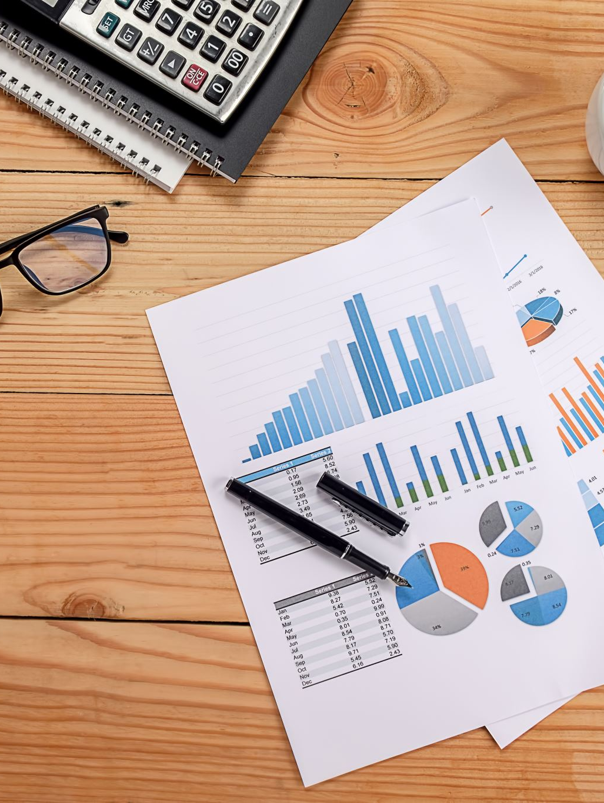
Protection Against Financial Loss
Direct Costs: Data breaches can lead to direct financial losses due to regulatory fines, legal fees, and compensation to affected individuals.
Indirect Costs: The loss of customer trust, damage to brand reputation, and potential business disruption can result in significant long-term financial losses.

Slide 17

Safeguarding Intellectual Property
Innovation Protection: For many companies, intellectual property (IP) such as patents, designs, and proprietary technologies is a critical asset. Data security is essential to protect these assets from theft or unauthorized access.
Competitive Advantage: Protecting IP ensures that a company maintains its competitive edge in the market.

Slide 18

Mitigating Insider Threats
Employee Access Controls: Data security measures help in controlling and monitoring access to sensitive information, reducing the risk of malicious or accidental data breaches by employees or other insiders.
Data Loss Prevention (DLP): Technologies and policies that prevent unauthorized transfer or leakage of data, whether intentional or unintentional, are crucial in mitigating insider threats.

Slide 19
Ensuring Ethical Responsibility
Data Stewardship: Organizations have an ethical responsibility to protect the data entrusted to them by customers, partners, and employees. Data security practices ensure that this responsibility is met.
Corporate Governance: Effective data security is a key component of good corporate governance, demonstrating that the organization is committed to ethical practices and the protection of stakeholder interests.

Slide 20
Adapting to Emerging Technologies
Cloud Security: With the increasing adoption of cloud computing, securing data stored and processed in cloud environments has become a priority.
IoT Security: The proliferation of Internet of Things (IoT) devices introduces new vulnerabilities, making it essential to secure data transmitted and stored on these devices.
AI and Big Data: As organizations leverage AI and big data analytics, ensuring the security of the vast amounts of data being processed and analyzed is critical.

Slide 21
Importance of Data Security
Protection of Sensitive Information
Compliance with Laws and Regulations
Preventing Data Breaches
Ensuring Business Continuity
Maintaining Customer Trust
Safeguarding Intellectual Property

Slide 22
Protection of Sensitive Information
Personal Privacy: Data security is essential for protecting personal information such as social security numbers, health records, financial details, and other sensitive data from unauthorized access. This helps prevent identity theft, financial fraud, and other forms of personal exploitation.
Corporate Confidentiality: Businesses rely on data security to protect confidential information, including trade secrets, proprietary research, customer databases, and strategic plans. Unauthorized access to this data can lead to competitive disadvantages and financial loss.

Slide 23
Compliance with Laws and Regulations
Legal Obligations: Many countries have stringent data protection laws, such as the General Data Protection Regulation (GDPR) in the European Union, which mandates organizations to implement robust data security measures. Non-compliance can result in severe penalties and legal consequences.
Industry Standards: Sectors like healthcare (HIPAA), finance (PCI-DSS), and others have specific regulatory requirements that dictate how sensitive data should be handled and protected. Adhering to these standards is critical for legal compliance and maintaining industry certifications.

Slide 24
Preventing Data Breaches
Cyber Threats: Data security helps protect against various cyber threats such as hacking, phishing, ransomware, and insider threats. A breach can result in the exposure of sensitive information, financial loss, and damage to an organization's reputation.
Data Integrity: Ensuring that data remains accurate and unaltered during storage and transmission is vital. Data security measures protect against unauthorized modifications, ensuring that the information remains trustworthy and reliable.

Slide 25
Ensuring Business Continuity
Disaster Recovery: In the event of a cyberattack, natural disaster, or system failure, data security measures like backups and encryption are essential for quickly restoring data and resuming business operations. This minimizes downtime and financial loss.
Operational Stability: Protecting data ensures that critical business operations can continue without disruption, maintaining the trust of customers and partners.

Slide 26
Maintaining Customer Trust
Reputation Management: Customers expect their data to be protected by the companies they interact with. A data breach can severely damage a company’s reputation, leading to loss of business and revenue. Strong data security measures demonstrate a commitment to protecting customer information.
Customer Loyalty: When customers know their data is secure, they are more likely to trust the company and remain loyal. Trust is a key factor in customer retention and long-term business success.

Slide 27

Safeguarding Intellectual Property
Innovation Protection: For businesses, intellectual property (IP) such as patents, designs, and proprietary technologies is a critical asset. Data security protects these assets from being stolen or misused, ensuring that the company retains its competitive edge.
Competitive Advantage: Protecting IP through data security measures helps prevent competitors from gaining unauthorized access to proprietary information, preserving the company’s market position.

Slide 28
Critical Data for Organization
Customer Data
Financial Data
Intellectual Property (IP)
Operational Data
Human Resources (HR) Data
Legal and Compliance Data
Sales and Marketing Data
Information Technology (IT) Data

Slide 29
Customer Data
Personal Identifiable Information (PII): Includes names, addresses, phone numbers, email addresses, social security numbers, and other data that can uniquely identify an individual.
Financial Information: Credit card details, bank account information, payment history, and purchase records.
Customer Preferences and Behavior: Data related to customer interactions, preferences, and behavior, which can be used for targeted marketing and improving customer service.

Slide 30

Financial Data
Accounting Records: General ledger, balance sheets, income statements, and other financial statements that provide a snapshot of the company's financial health.
Tax Information: Records related to tax filings, payments, and deductions, which are crucial for compliance with tax regulations.
Payroll Data: Information about employee salaries, bonuses, tax withholdings, and benefits, which must be accurate and secure.
Budgeting and Forecasting Data: Financial projections, budgets, and planning documents that are essential for strategic decision-making.

Slide 31
Intellectual Property (IP)
Patents and Trademarks: Legal documentation related to patents, trademarks, and copyrights that protect the company’s innovations and brand.
Proprietary Research and Development (R&D): Data related to new products, technologies, and processes that are in development, which can give the company a competitive edge.
Trade Secrets: Information that is not publicly known and gives a company a competitive advantage, such as formulas, algorithms, or proprietary processes.

Slide 32
Operational Data
Supply Chain Information: Data related to suppliers, logistics, inventory levels, and order processing, which is essential for the smooth operation of the business.
Manufacturing Processes: Information about production techniques, quality control measures, and process optimizations.
Project Management Data: Timelines, project plans, resource allocations, and status reports that are critical for managing ongoing projects and ensuring timely delivery.

Slide 33
Human Resources (HR) Data
Employee Records: Personal information, employment history, performance evaluations, and disciplinary actions.
Compensation and Benefits Data: Details of employee compensation, benefits, retirement plans, and stock options.
Recruitment Data: Information about job applicants, interviews, and hiring decisions, which must be kept confidential.
Training and Development: Records of employee training, certifications, and professional development activities.

Slide 34
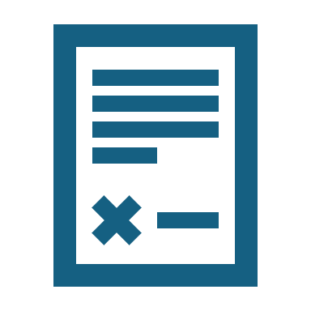
Legal and Compliance Data
Contracts and Agreements: Legal documents such as contracts with clients, suppliers, and partners, which are binding and critical to business operations.
Compliance Documentation: Records related to regulatory compliance, such as environmental standards, labor laws, and industry-specific regulations.
Litigation Records: Information related to ongoing or past legal cases, including evidence, court filings, and settlement agreements.

Slide 35
Sales and Marketing Data
Customer Relationship Management (CRM) Data: Information about customer interactions, sales history, and service records.
Sales Performance Data: Sales targets, quotas, and performance metrics that are used to assess the effectiveness of the sales team.
Marketing Campaigns: Data related to marketing strategies, advertising campaigns, and promotional activities, including budgets and ROI.

Slide 36
Information Technology (IT) Data
System Configuration: Information about the organization’s IT infrastructure, including server configurations, network topologies, and software installations.
Security Logs: Logs of access to systems, audit trails, and records of security incidents, which are crucial for monitoring and responding to threats.
Backup Data: Copies of critical data that are stored securely for recovery in case of data loss or corruption.
Disaster Recovery Plans: Documentation of processes and procedures for recovering data and restoring operations after a disaster.

Slide 37
Elements to consider for better security mechanism
Risk Assessment and Management
Access Control
Data Encryption
Network Security
Endpoint Security
Incident Response and Management
Disaster Recovery and Business Continuity

Slide 38
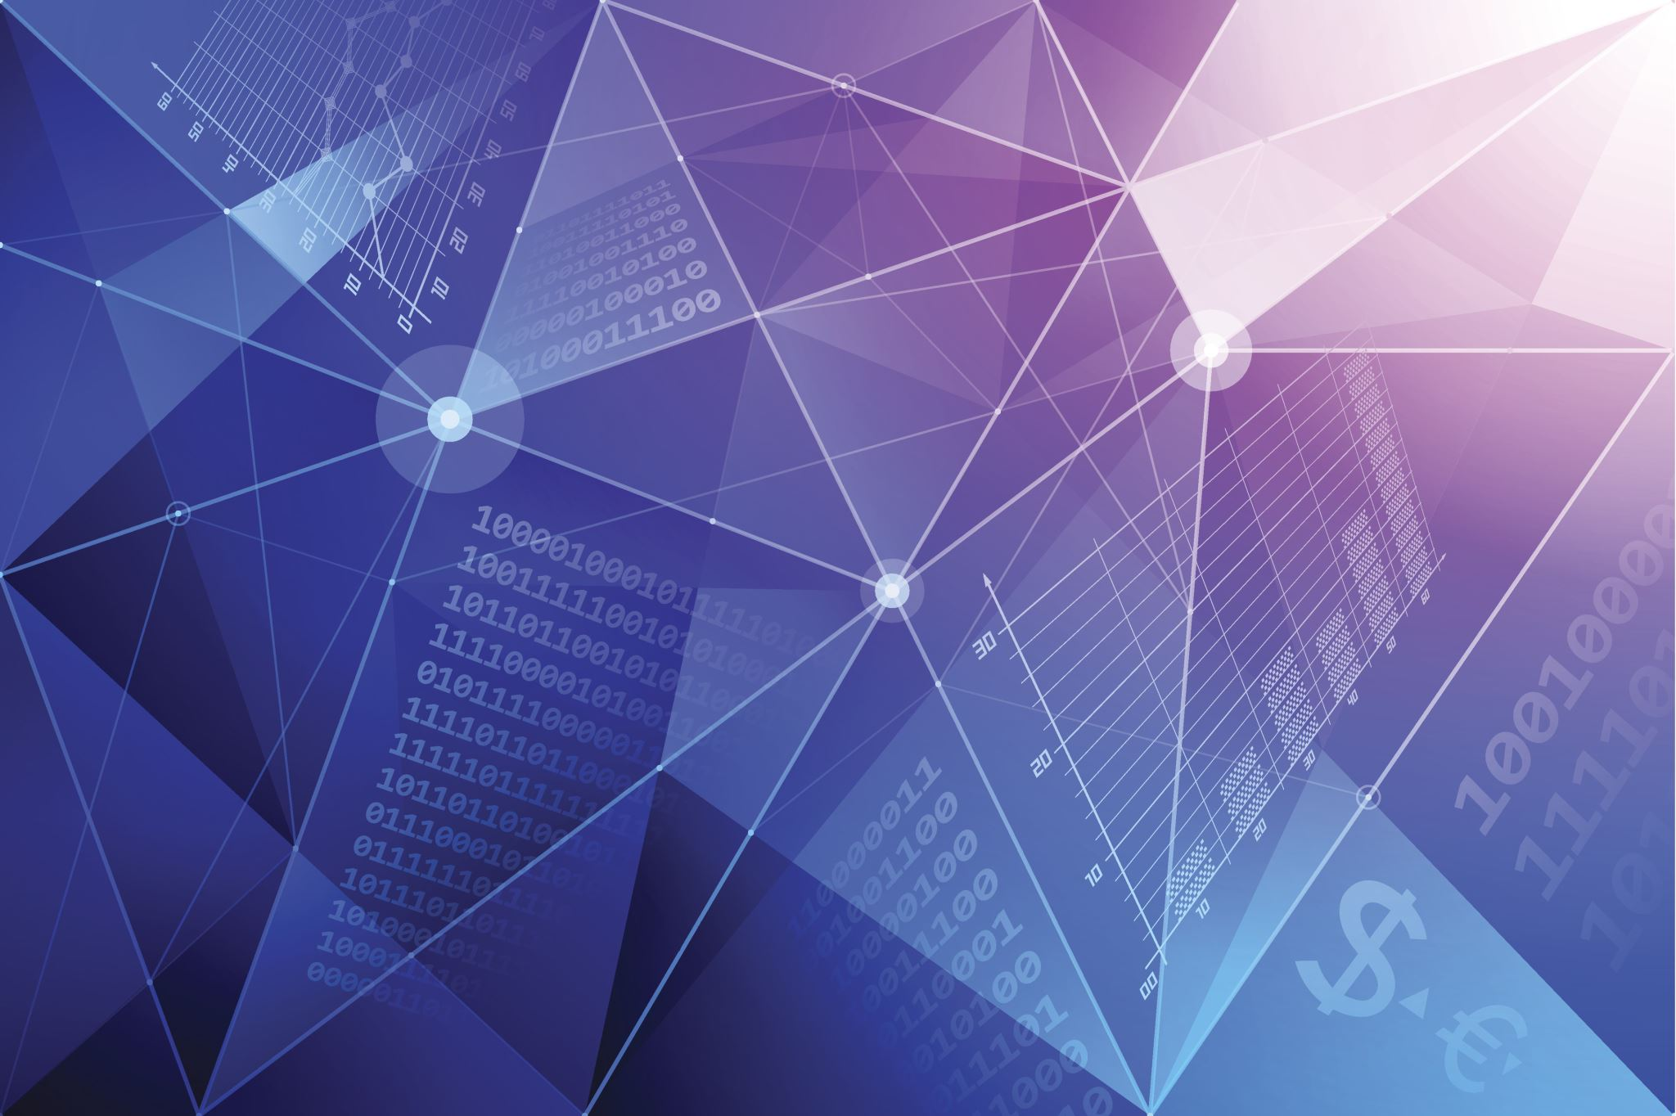
Risk Assessment and Management (RAM)
Identify Assets: Determine the critical assets that need protection, such as data, infrastructure, applications, and intellectual property.
Threat Analysis: Identify potential threats, including cyberattacks, insider threats, natural disasters, and human error.
Vulnerability Assessment: Evaluate vulnerabilities in the system, including software flaws, weak configurations, and unpatched systems.
Risk Mitigation: Develop strategies to mitigate identified risks, such as implementing security controls, patch management, and disaster recovery plans.

Slide 39
Access Control
Authentication: Implement strong authentication mechanisms (e.g., multi-factor authentication) to verify user identities before granting access to resources.
Authorization: Define and enforce policies to ensure that users only have access to the resources they need to perform their jobs (principle of least privilege).
Role-Based Access Control (RBAC): Assign permissions based on roles within the organization, simplifying management and reducing the risk of unauthorized access.
Identity and Access Management (IAM): Use IAM systems to manage user identities, enforce access policies, and track user activity across systems.

Slide 40
Data Encryption
Encryption at Rest: Protect stored data by encrypting it, ensuring that even if physical storage is compromised, the data remains secure.
1
Encryption in Transit: Encrypt data during transmission over networks to prevent interception and unauthorized access.
2
Key Management: Implement secure key management practices, including key generation, storage, rotation, and destruction.
3
End-to-End Encryption: Ensure data is encrypted from the source to the destination, minimizing exposure to unauthorized access during transit.
4

Slide 41
Network Security
Firewalls: Deploy firewalls to control incoming and outgoing network traffic based on predetermined security rules.
Intrusion Detection and Prevention Systems (IDPS): Use IDPS to monitor network traffic for suspicious activity and automatically respond to potential threats.
Virtual Private Networks (VPNs): Use VPNs to secure remote connections and protect data transmitted over public networks.
Network Segmentation: Divide the network into smaller segments to contain potential breaches and limit the spread of malware.

Slide 42
Endpoint Security
Anti-Malware Software: Install and regularly update anti-malware software on all endpoints to protect against viruses, spyware, and other malicious software.
Endpoint Detection and Response (EDR): Implement EDR solutions to continuously monitor endpoints for suspicious activity and provide real-time response capabilities.
Patch Management: Regularly update software and firmware on all devices to protect against known vulnerabilities.
Device Control: Control the use of external devices, such as USB drives, to prevent unauthorized data transfer and malware introduction.

Slide 43

Application Security
Secure Software Development Lifecycle (SDLC): Integrate security into every phase of the software development lifecycle, from design to deployment.
Code Reviews and Testing: Conduct regular code reviews, static code analysis, and penetration testing to identify and fix security vulnerabilities.
Application Whitelisting: Implement whitelisting to allow only approved applications to run on systems, reducing the risk of unauthorized software execution.
Web Application Firewalls (WAF): Use WAFs to protect web applications from common threats, such as SQL injection, cross-site scripting (XSS), and DDoS attacks.

Slide 44
Incident Response and Management
Incident Response Plan (IRP): Develop and maintain a comprehensive IRP that outlines the steps to take in the event of a security incident.
Incident Detection: Implement systems to quickly detect and alert on potential security incidents.
Incident Containment: Define procedures to contain the impact of a security incident, preventing further damage.Post-Incident Analysis: Conduct a thorough post-incident analysis to understand the root cause, improve defenses, and update the IRP.

Slide 45
Disaster Recovery and Business Continuity
Implement
Backup Solutions: Implement regular and secure backups of critical data to ensure recovery in the event of data loss or corruption.
Develop and test
Disaster Recovery Plan (DRP): Develop and test a DRP that outlines how to restore systems and data after a catastrophic event.
Ensure
Business Continuity Planning (BCP): Ensure that the organization can continue critical operations during and after a security incident or disaster.
Implement
Redundancy and Failover: Implement redundant systems and failover mechanisms to maintain availability and minimize downtime.

Slide 46

Thank you

